Slide 1

INNOVADORS LAB PVT LTD
Notes:
Replace it with original image. Add logo in every page.

Slide 2
About Us
Incorporated in 2010.
A team of senior experts.
90% of tech staff has Bachelor Degree in computing and engineering.
3 out of 4 of our customers choose us for long-term projects.
End-to-end software development services and GIS Solutions for both IT and non-IT ventures and entrepreneurs.
An 100% EOU and ISO 9001:2008 Certified Company.
An Empanelled Company of ORSAC and IDCOL.
Recognized by Department of Science and Technology and MSME, Govt of India.
A Pvt Limited Company Registered under Company Registration Act.
It is a Net Profit company.
▪ We are working nationwide, with our assets capable of serving clients’ requirements in multiple states of India.

Slide 3
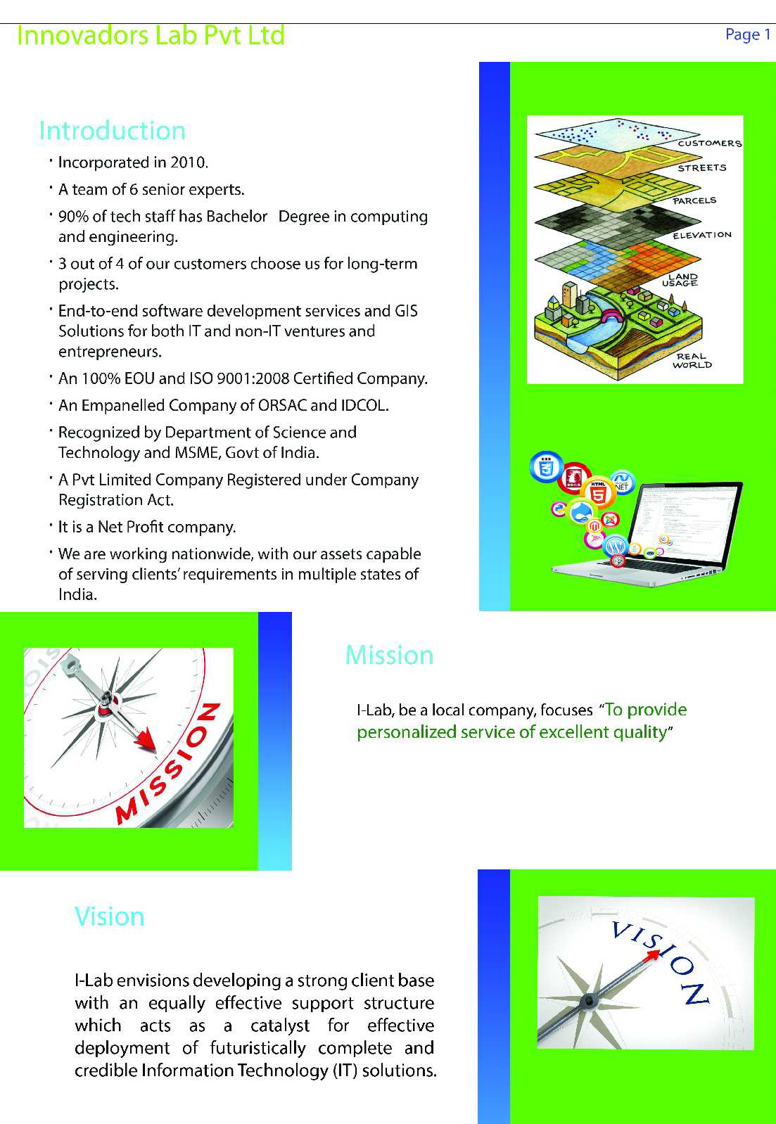
Notes:
Introduction in 2nd slide. Vision, mission and commitment in 3rd slide. Our services in 4th slide

Slide 4
Mission
I-Lab, be a local company, focuses “To provide personalized service of excellent quality”
Vision
I-Lab envisions developing a strong client base with an equally effective support structure which acts as a catalyst for effective deployment of futuristically complete and credible Information Technology (IT) solutions.
Our Commitment to Quality
Innovadors Lab:
Believes in working co-operatively with clients to design processes that achieve sound objectives with integrity.
Uses the latest technology and methodologies to achieve strategic outcomes for clients. Works from a position of respect that values confidentiality and equality of access. Emphasises flexibility in order to respond to the dynamic nature of projects. Seeks out consultancies that have at their heart issues of technology capabilities and solution

Slide 5
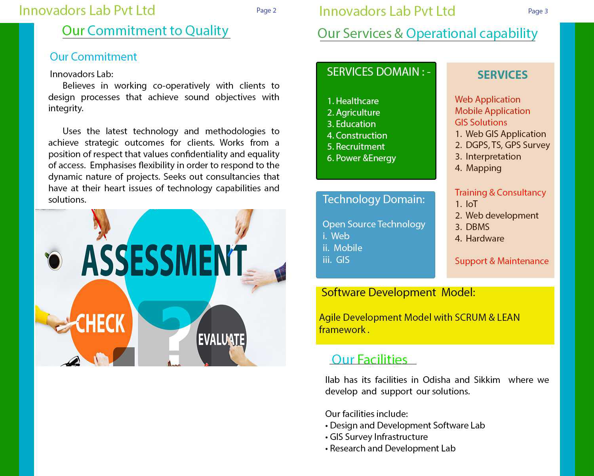
Our Services

Slide 6
GIS Capabilities
Survey
GPS, DGPS& ETS Survey
GIS Data Capture Services
Scanning, Manual Digitizing, Vectorization, Photogammetry
Utility Mapping Services
Water mains, data lines, telephone lines, power lines, gas mains, and sewer lines
Municipal GIS
to manages various tasks of a municipality such as Property Tax, land property details, Birth and Death Registration, Socio Economic Data management & Holding registration etc
Parcel Mapping
parcel maps to Urban and Rural governing bodies for Land administration & property registration activities; Municipality planning & Urban development to restore analytical data which is crucial for enhancing the operational abilities
GIS Application Development
• Design, Development and Maintenance of Geospatial Databases
• Database Migration on Cross Platforms
• Application Migration on Cross Platforms
• Mobile Spatial Information System
• SDI (spatial Data Infrastructure)
• Open Source Environment
Topographic Mapping and Cadastral Mapping

Slide 7
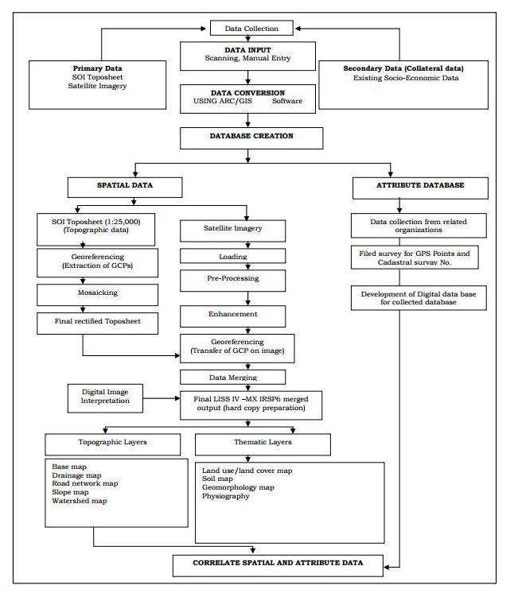
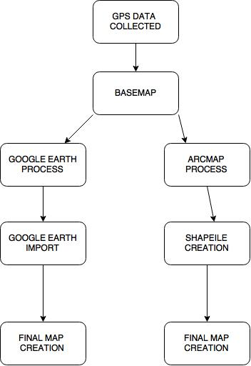
Implementation Process
Base Map Process Image Digitization Process

Slide 8
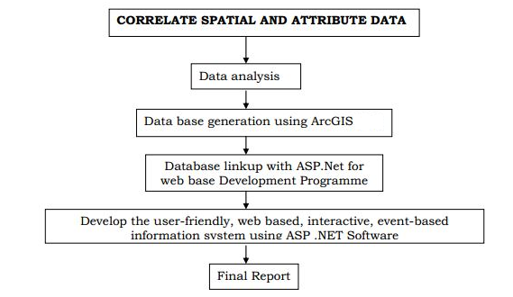
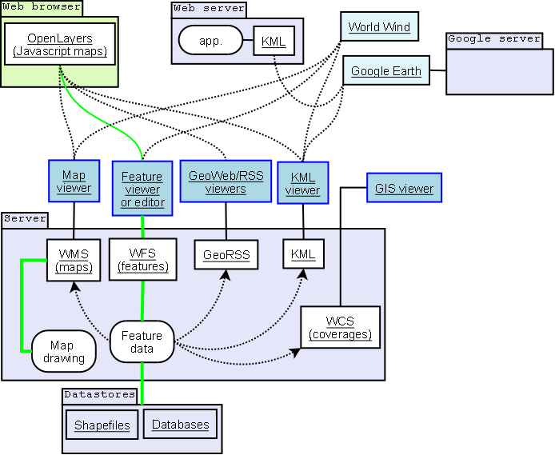
Vision, Mission and Process
GIS Application Process

Slide 9
Survey
Customers | Business Activity | Project Period | Location | Purpose
ORSAC and Power Grid Corporation | DGPS Survey | 2017 | Jharsuguda, Odisha | Study of Geo-coordinates for preparation of Geo-referenced maps in connection with proposed diversion of revenue forest land
BDA | Encroachment Survey through GPS | 2015 | Bhubaneswar, Odisha | Asset Identification with Encroachment status
BDA | DGPS Survey | 2015 | Biju Patnaik, Airport, Bhubaneswar | Airport Expansion
RWSS | GPS Survey for PWS | 2015 | 20 Blocks of Odisha, 5 Districts | Longitide and Lattitude survey of pws points with imagery
OMC | DGPS | 2018 | Laxmipur Tehsil, Kakriguma Mines, Koraput | 33KV Transmission Line
CED and Directorate of Water Resources, Odisha | DGPS | 2015 | Pipli and Nimapara | NAC Survey for improvement of water supply to households
CED and Andhra Prdesh Govt | DGPS Survey | 2014 | 9 ULBS in Andhra Pradesh Region | ULB Survey under APMDP Project
CED and Telengana Govt | Attribute Survey through GPS | 2015 | 3 ULBS of Telengana | ULB Survey under MDP Project

Slide 10
Base Map
Customers | Business Activity | Project Period | Location | Purpose
BDA | Basemap Preparation | 2015 | Bhubaneswar, Odisha | Asset Identification with Encroachment status
BDA | Basemap Preparation | 2015 | Biju Patnaik, Airport, Bhubaneswar | Airport Expansion
CED and Andhra Prdesh Govt | Basemap Preparation | 2014 | 9 ULBS in Andhra Pradesh Region | ULB Survey under APMDP Project
CED and Telengana Govt | Basemap Preparation | 2015 | 3 ULBS of Telengana | ULB Survey under MDP Project

Slide 11
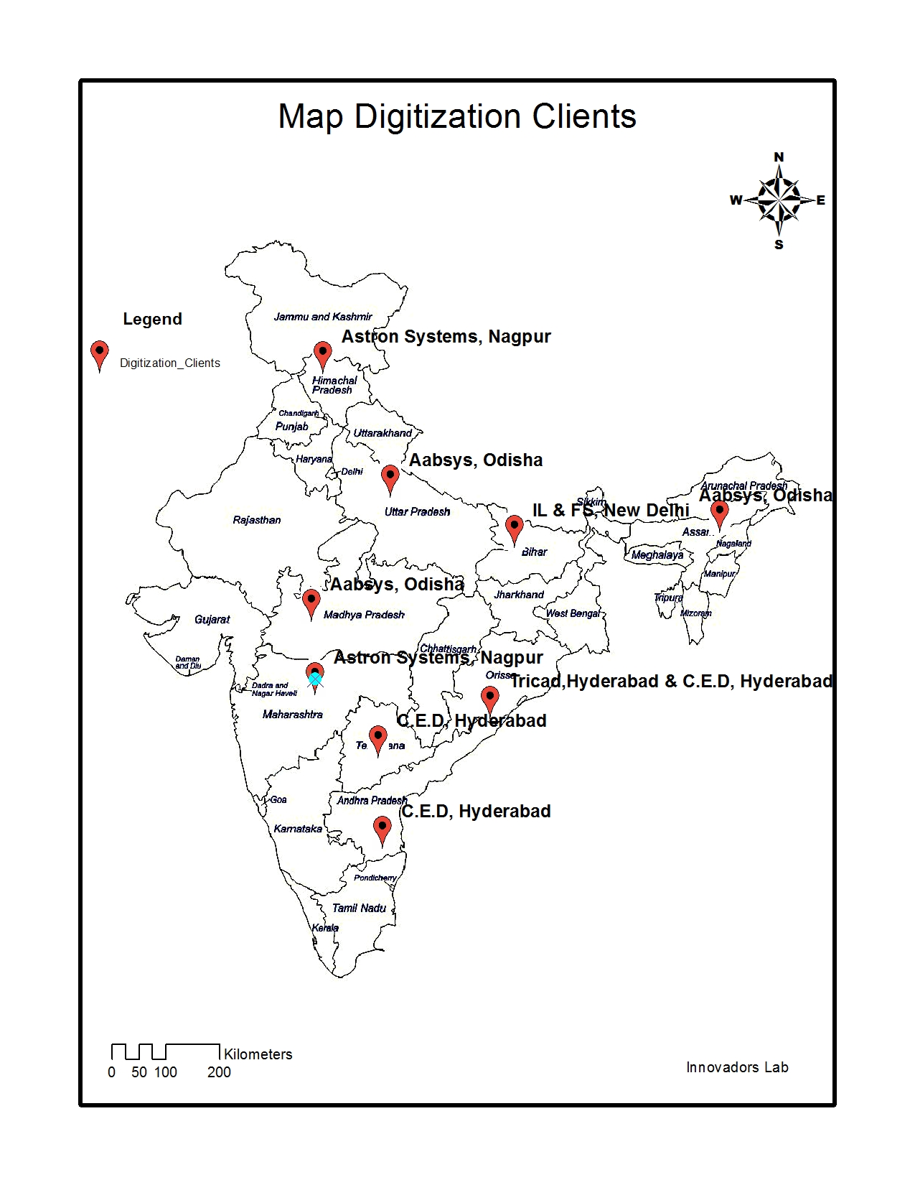
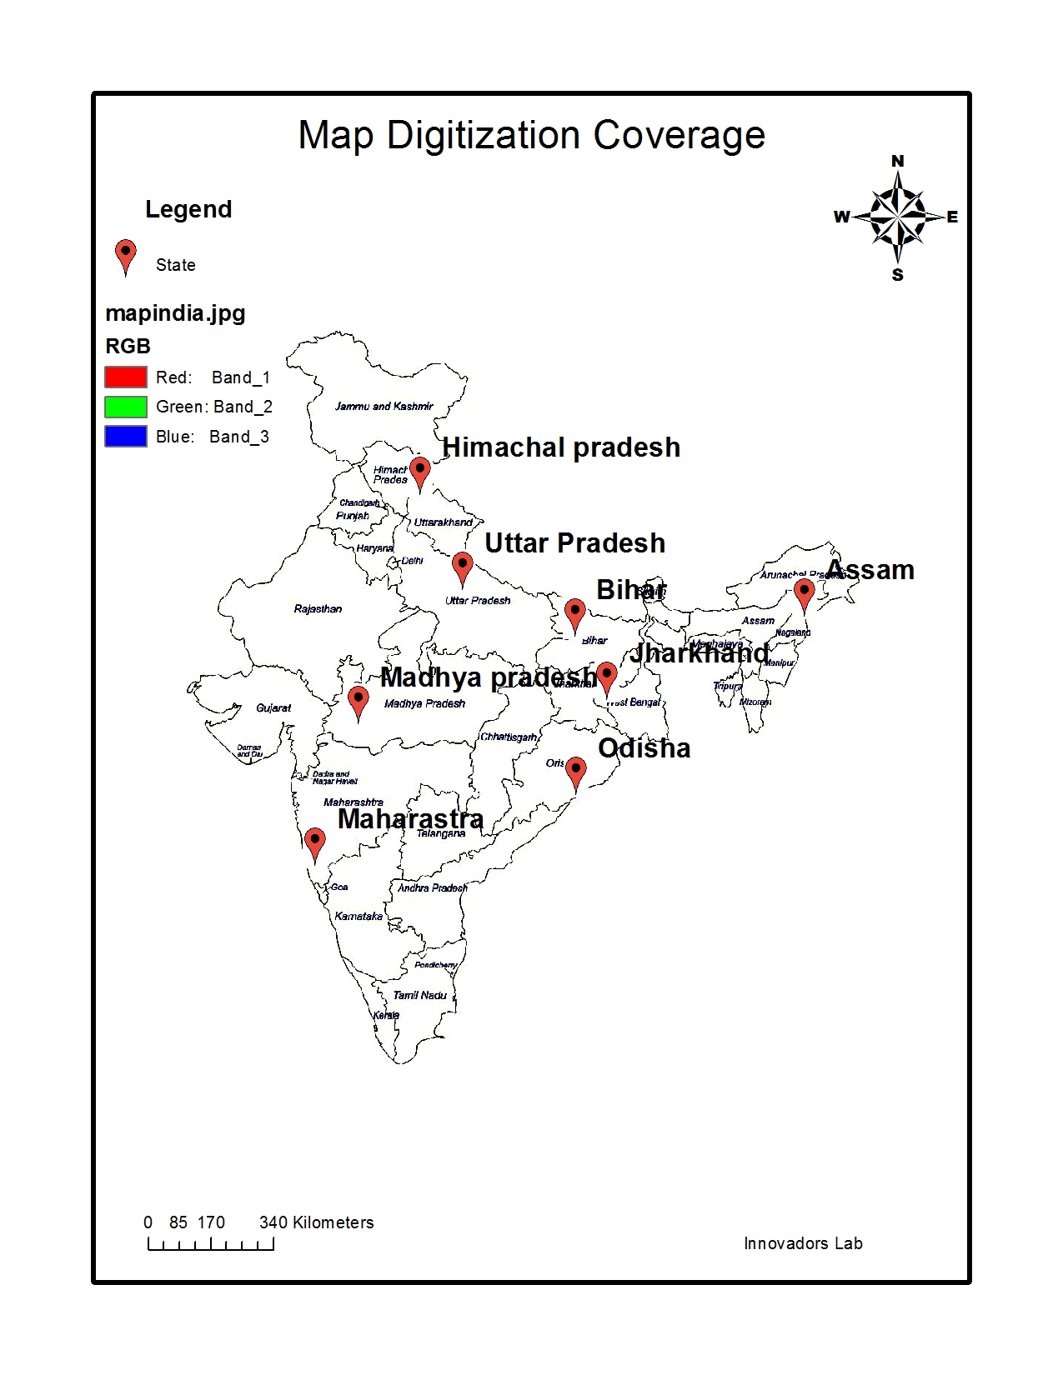
Map Digitisation
Scope of Work: Land Record Digitization (Village Map)
Road Network Digitization
2D Building Capture

Slide 12
Our Contact
Corporate Office: C, Ground Zero, STPI Complex, Fortune Towers, Bhubaneswar, Odisha-751021
Development Centre 1: Address: C, Ground Zero, STPI Complex, Fortune Towers, Bhubaneswar,
Odisha-751021
Development Centre 2- STPI Complex, Jewels Building, Tadong, Gangtok, Sikkim
www.innovadorslab.co.in
Email:contact@innovadorslab.co.in
Ph#: 0674

Slide 13
Organogram
Management Team
Advisors
Software Division
GIS Division
Consultancy and Training Division
Support and maintenance
Business Development Team
Project Lead
Execution Team
Project Lead
Execution Team
Project Lead
Execution Team
Project Lead
Execution Team
Associates and Partners
Statutory and Finance
Consultant
Consultant
Consultant
Consultant

Slide 14
Certificate
Notes:
Add ISO certificate here

Slide 15
Clients
Notes:
Add clients logo here

